Slide 1


State Geothermal Data and the US Geoscience Information Network
System Design and Progress Report
Stephen M Richard, AZGS
CSIG 2011, SDSC
Funding from the National Science Foundation under award EAR-0753154 to the AZGS, acting on behalf of the Association of American State Geologists and by the U.S. Department of Energy under award DE-EE1002850 to the AZGs acting on behalf of the Association of American State Geologists

Slide 2
rOADMAP
Background
Approach
Metadata
Services
Interchange formats
Current status
Architecture and artifacts
Way forward

Slide 3
Background
February, 2007: Representatives of Association of American State Geologists (AASG) and U. S. Geological Survey (USGS) meet
Explore making their data accessible and interoperable.
Recommend that the geological surveys work together to create a distributed, national “Geological Information Network” (GIN) of digital data
use of common standards and protocols
respect ownership or control of data
builds on existing data systems (AZGS Open-file Report 2008-01, 2008).
USGIN, Interoperability and the National Geothermal Data System

Slide 4



US Geoscience Information Network
Partnership between the Association of American State Geologists (AASG) and the US Geological Survey (USGS)
Objective is to make geoscience information easier to find, distribute, and analyze
Customers:
Government agencies (regulatory, land management)
Commercial users (mineral exploration, engineering, environmental)
Researcher
Educators

Slide 5
What are the resources
Geologic maps
Gray literature (files, theses, unpublished reports)
Core and cuttings repositories
Oil and Gas well records and logs
Water well records and logs
Data compilations – geochemical, geophysical, mineral resource, etc. etc…

Slide 6
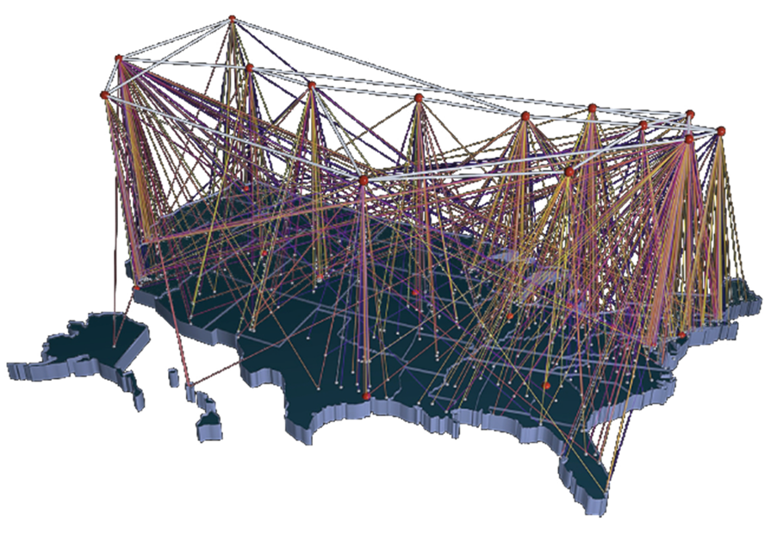
Distributed Network
Benefits of a distributed network:
Keeps information in the hands of the data providers
Allows for simpler update routines
Allows new information to be more rapidly conveyed to users
Information is increasingly brought to us from disparate sources
Constantly improving search capabilities allow us to find all this information

Slide 7
Loose coupling between data provider and consumer
KML
GeoSciML
WaterML

Slide 8
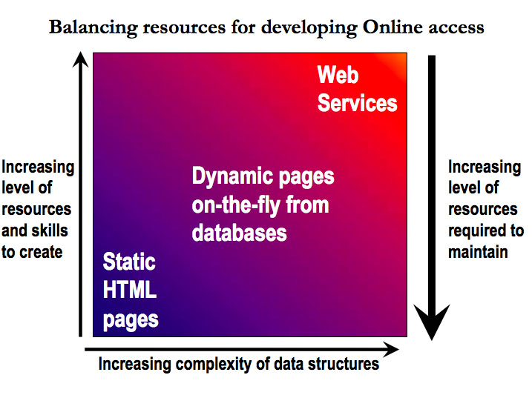
Shift the Burden from the User to the Provider
Web Services
Dynamic pages on the fly from database
Effort to maintain
Effort to create
Static HTML pages
Effort to get data
More complex data management
Peter Fox, RPI, 2010
Notes:
8
8
8
In the “heroic” era of science, the provider of data plays a relatively passive role. The onus is on the user to identify each data source, accumulate the required data, and prepare the data for assimilation and analysis. A similar process applies for acquiring software for analysis, modeling, and visualisation. In many cases, the user and the provider are the same person.
In an interoperable e-Science world, the provider has to put much more work into describing the structure and content of data and information, and someone has to provide and support Web Services. The user is relieved of these burdens and benefits accordingly. The overall reduction in work load is enormous, but the provider does not see that.

Slide 9
Shift the Burden from the User to the Provider
Server-side data integration– standard interchange data schema
Access to data from within user applications
Notes:
9
9
9
In the “heroic” era of science, the provider of data plays a relatively passive role. The onus is on the user to identify each data source, accumulate the required data, and prepare the data for assimilation and analysis. A similar process applies for acquiring software for analysis, modeling, and visualisation. In many cases, the user and the provider are the same person.
In an interoperable e-Science world, the provider has to put much more work into describing the structure and content of data and information, and someone has to provide and support Web Services. The user is relieved of these burdens and benefits accordingly. The overall reduction in work load is enormous, but the provider does not see that.

Slide 10
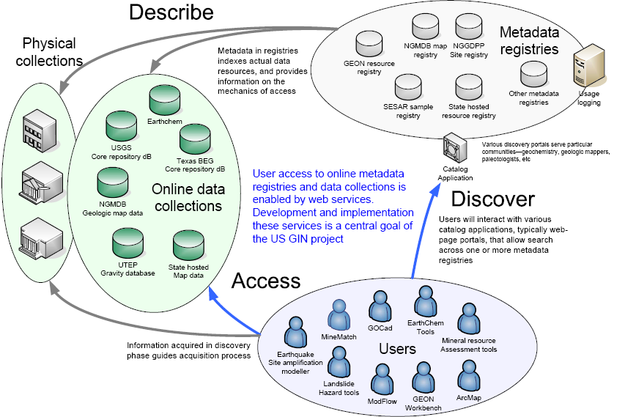
USGIN System overview

Slide 11

The National Geothermal Data System
DOE Geothermal Technologies Program-funded projects
DOE & USGS
Data
Boise State University
National
Assessment
USGS
University Data
Southern
Methodist
University
State Geological
Survey Data
AASG - AZGS

Slide 12
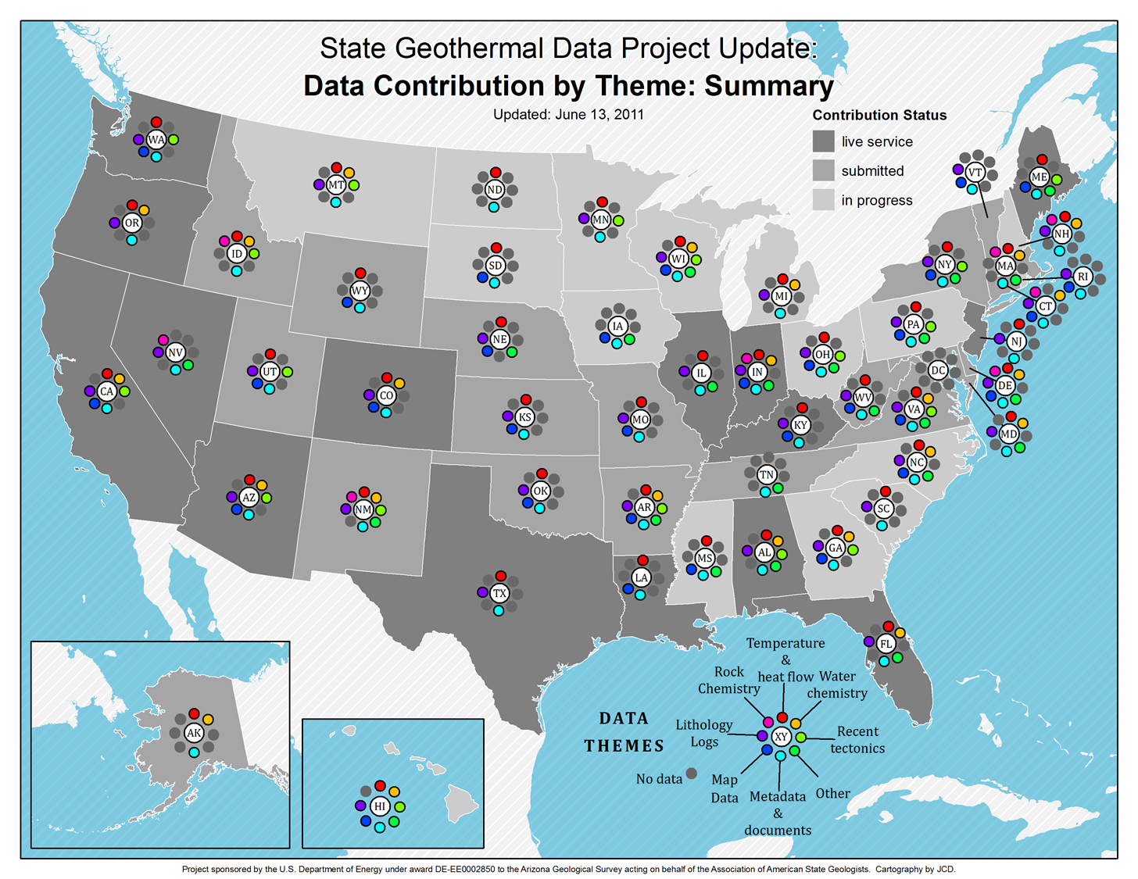

Slide 13
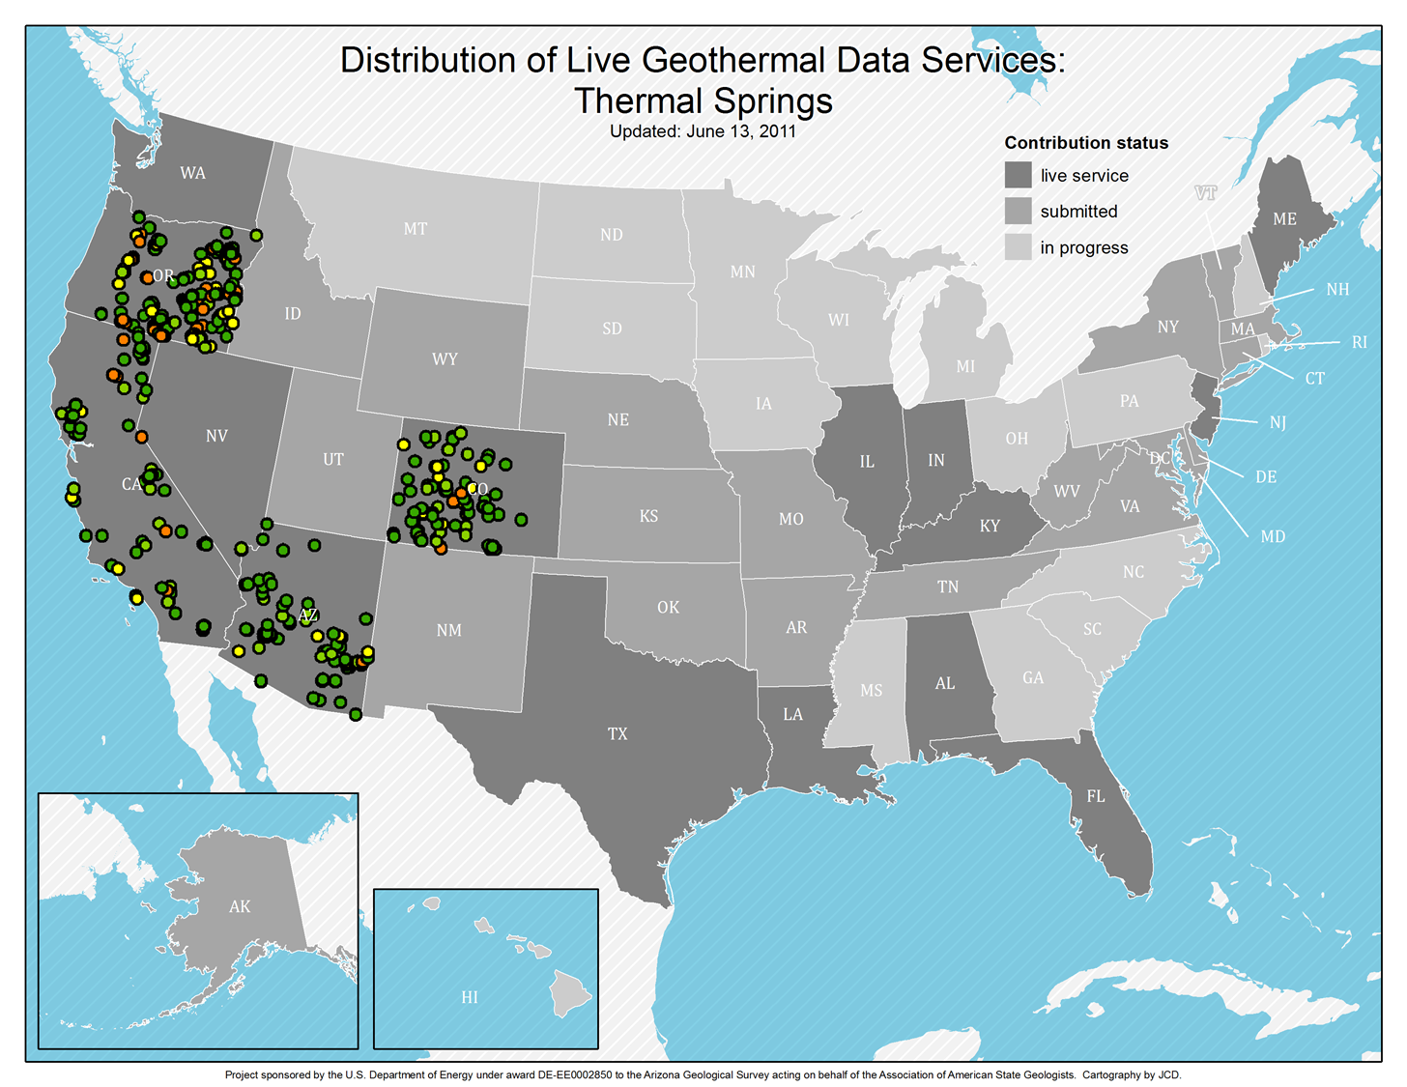

Slide 14
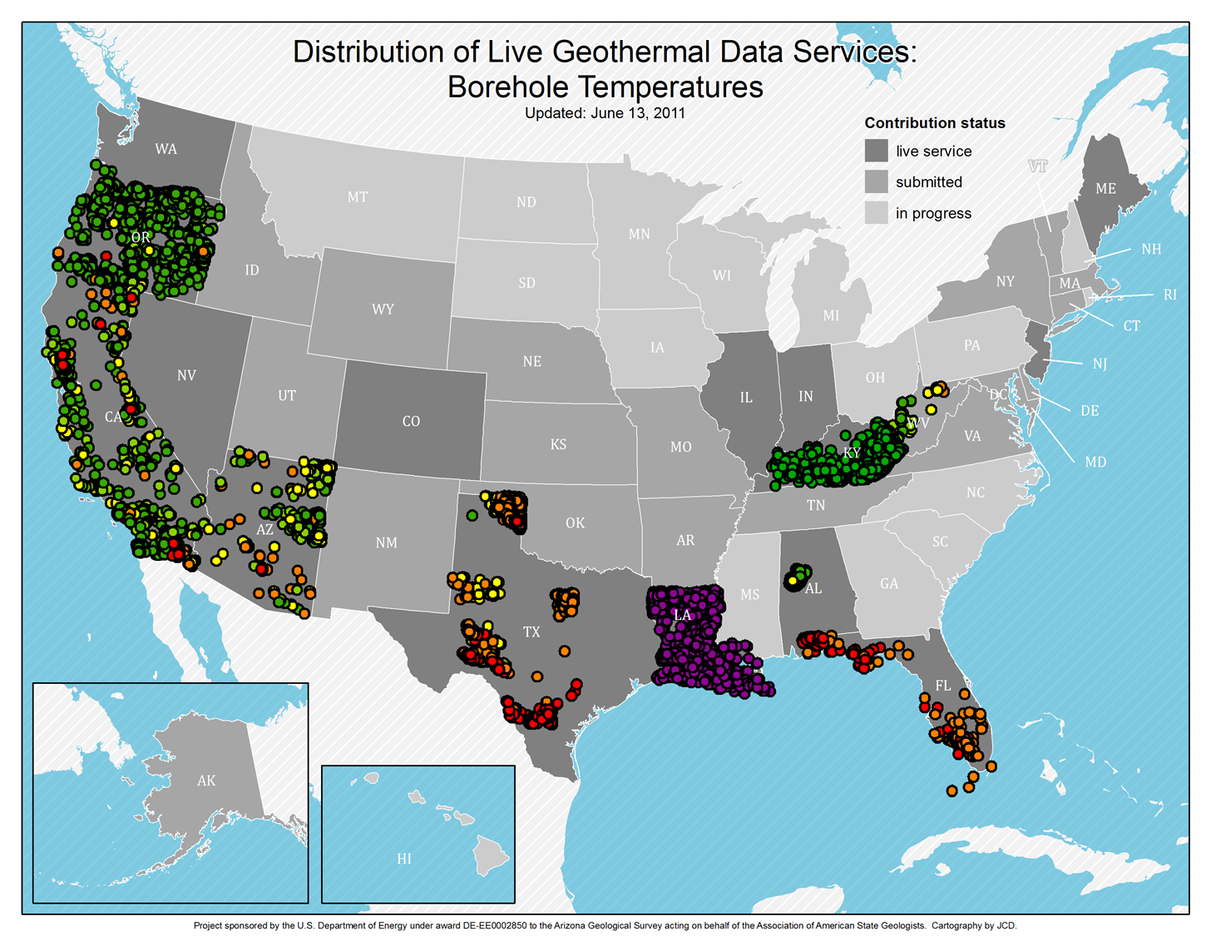

Slide 15

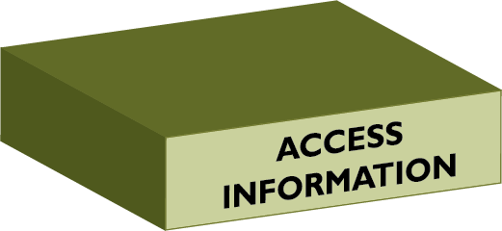

The Approach
… in Three “Easy” Steps
Interoperability
We want mash-ups that work
Analyze: Provide data services in dataset-specific standardized schema
Access: Provide resources themselves online using standard OGC protocols
Find: Provide standardized metadata for resources that may or may not be available online

Slide 16
Metadata Implementation
USGIN Profile and Custom Software

Slide 17
Development history
Review existing standards (FGDC, Dublin Core, ISO19115)
Define user scenarios
Metadata content requirements based on those
Explore service-based metadata search tools (Deegree, GeoNetwork)
Usage guidelines document for ISO19115/19139 on CSW 2.0.2
Geonetwork prototype
Switch to ESRI Geoportal after testing when it was opened
Populate catalog through various approaches

Slide 18
What’s it for?
Find, evaluate, get resources
Bounding box, keywords, author, title, date…
Resource– identifiable item of interest
Data vs metadata: Catalog is ‘high level’
In catalog
Documents, physical samples, datasets, services, software, files, databases
Not in catalog
Individual database records--polygons in a GIS dataset, chemical analyses, temperature measurements
Domain specific description information

Slide 19
Metadata Content
Title
Description
Extent
Geographic
Vertical
Temporal
Keywords
Originator(s)
Date
Resource ID
Access instructions
Access constraints
Language
Quality
Lineage
Citation
Distribution contact
Metadata
Date
Contact
Specification
Identifier
Online document: http://lab.usgin.org/profiles/doc/metadata-content-recommendations

Slide 20
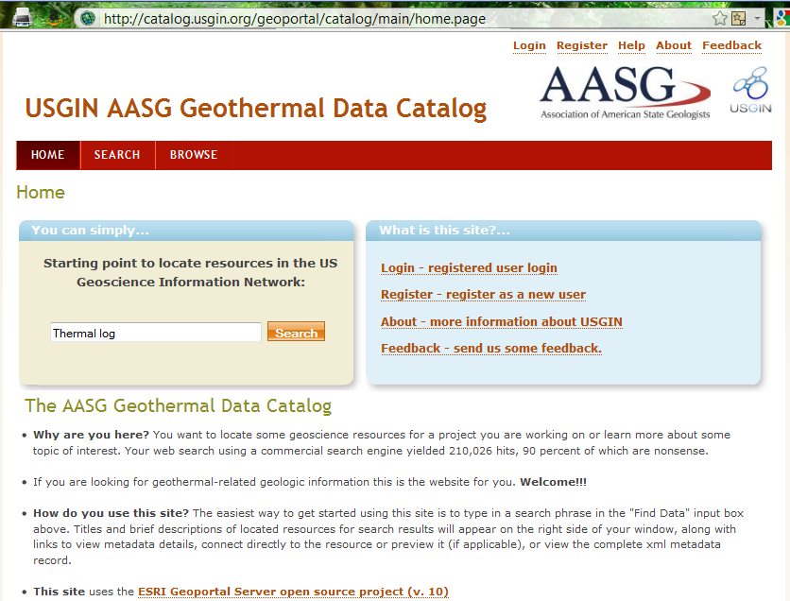

Slide 21
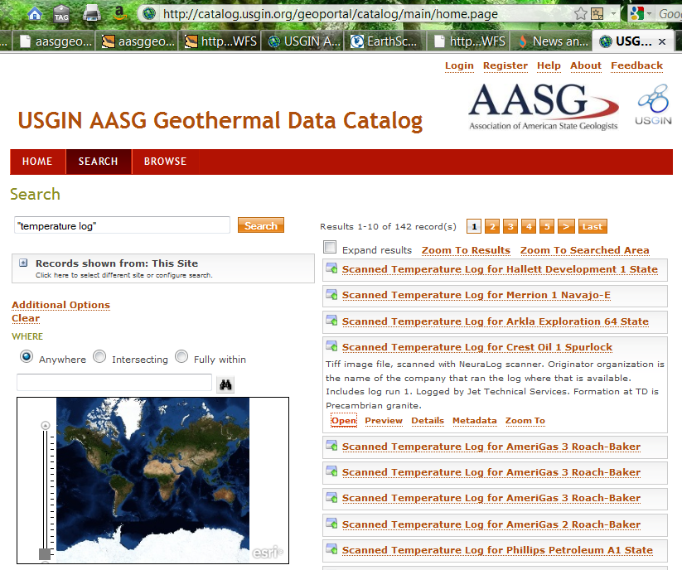
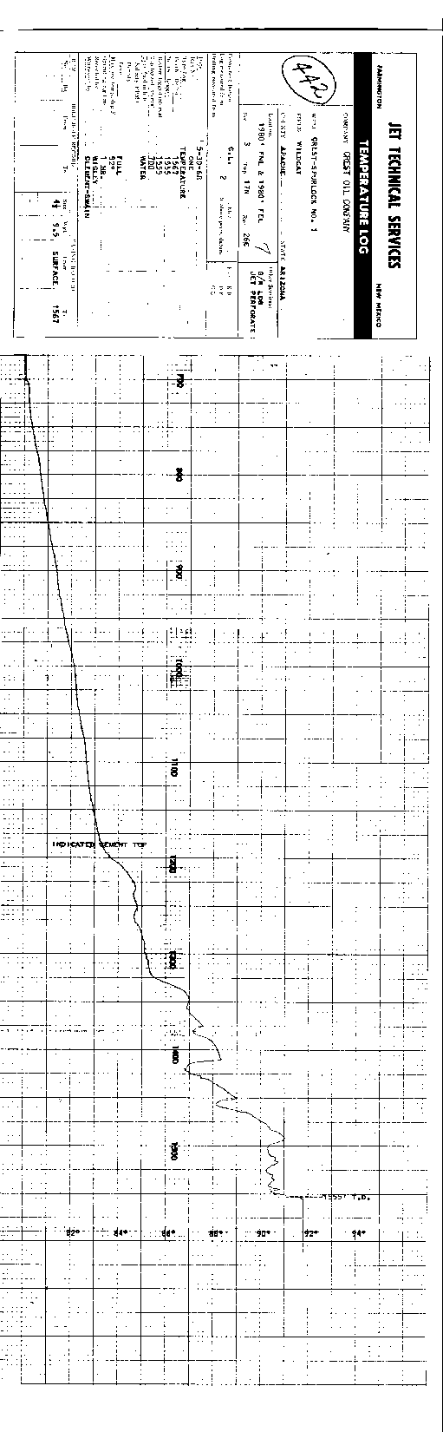

Slide 22
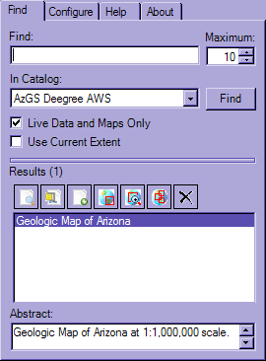
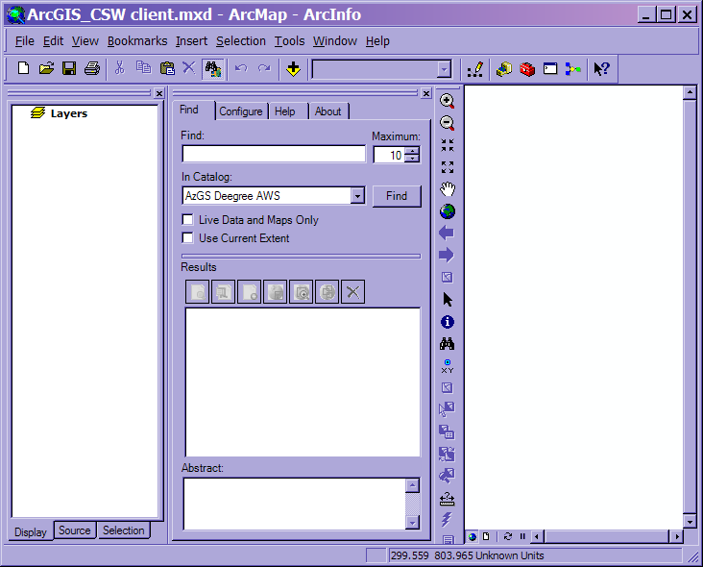
ESRI ArcGIS CSW Client

Slide 23
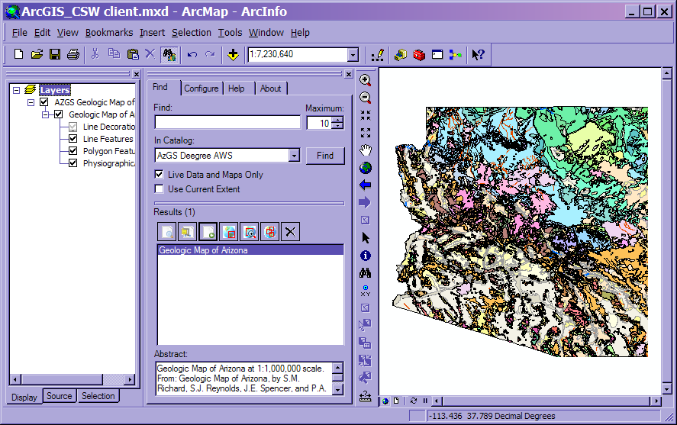
Display WMS in ArcMap

Slide 24

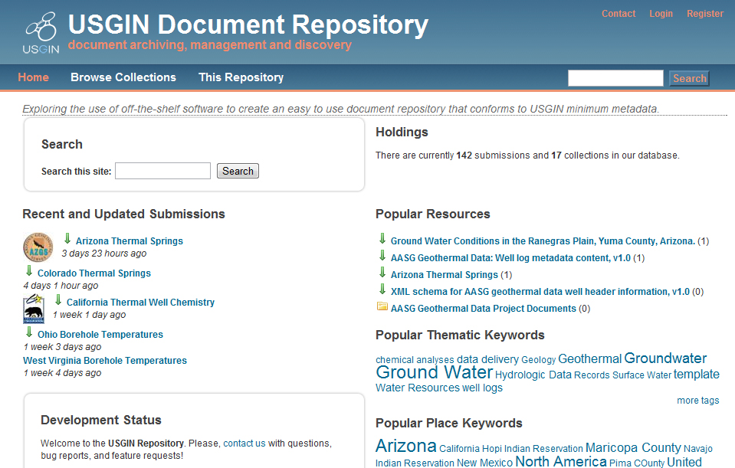
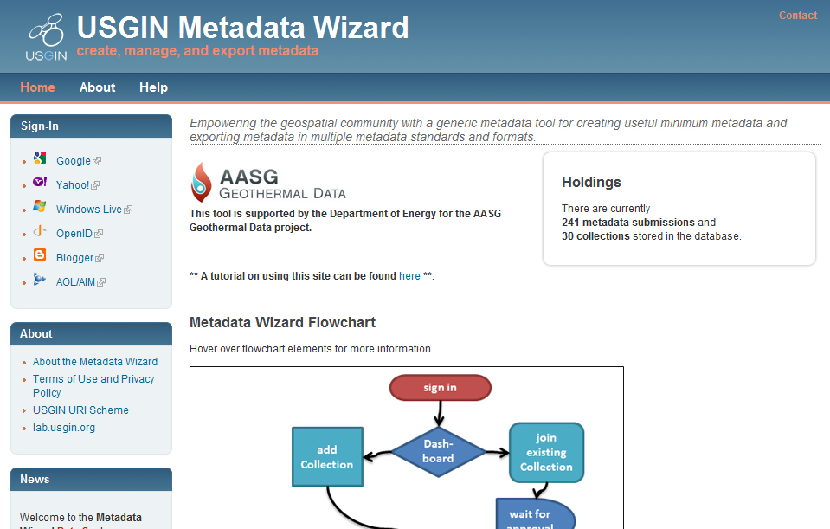
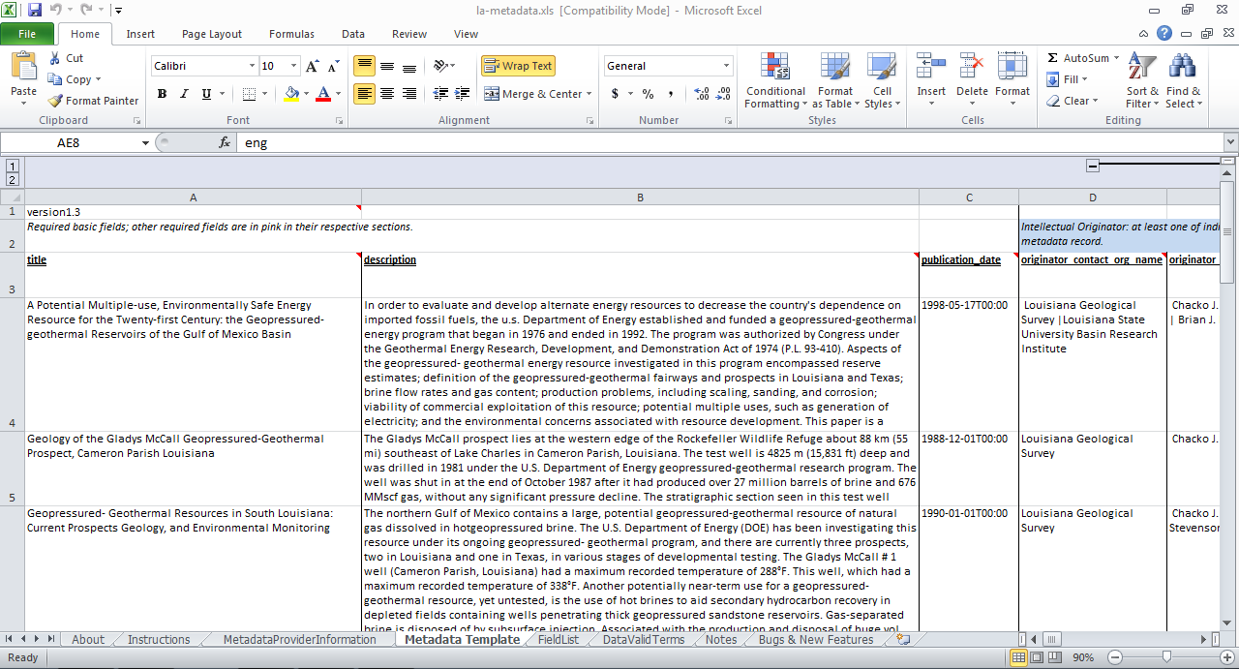

USGIN Metadata Implementation
Metadata Creation and Inclusion in a Catalog
Four Options:
Write XML, upload to Catalog
Excel Sheet + Python
For bulk updates, ETL
Metadata Wizard
For offline resources or resources already online
Document Repository
For resources that need to be made available online

Slide 25



USGIN Catalog Implementation
Why a Geoportal Catalog?
Allow a variety of metadata creation methods to be aggregated
Allow distributed metadata records to be aggregated: harvesting between catalogs
Provide a consistent interface for searching and retrieving metadata records: CSW
Why ESRI’s Geoportal Server?
Geonetwork was too hard
They made it open source!
Metadata Wizard
Document Repository
Excel Template
XML in Web-Accessible Folder
Another Catalog
Another Catalog
Geoportal Catalog

Slide 26
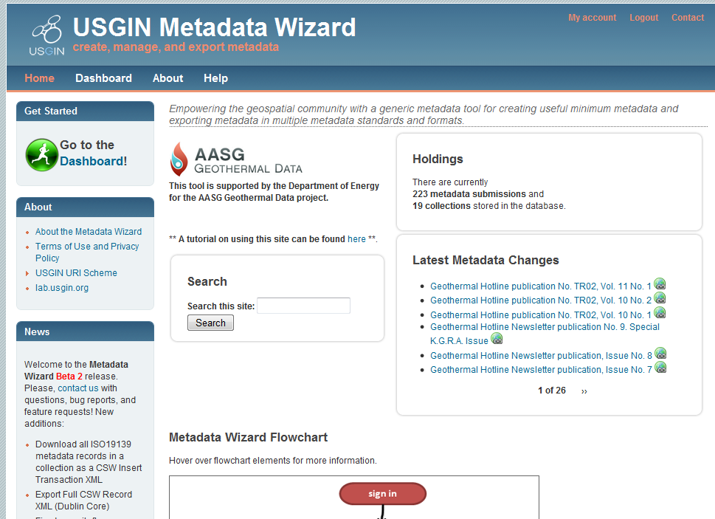
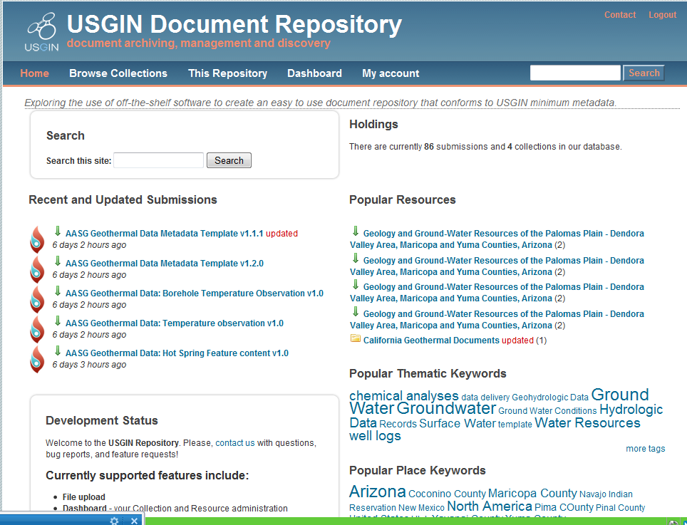
Drupal-based metadata tools
Home pages look different, but metadata creation is the same
User defines collections
Metadata created in context of a collection
Published records get pushed to WAF for harvest
Drupal provides features for autocomplete, simple validation
Complex web of dependencies between Drupal modules hard to maintain

Slide 27
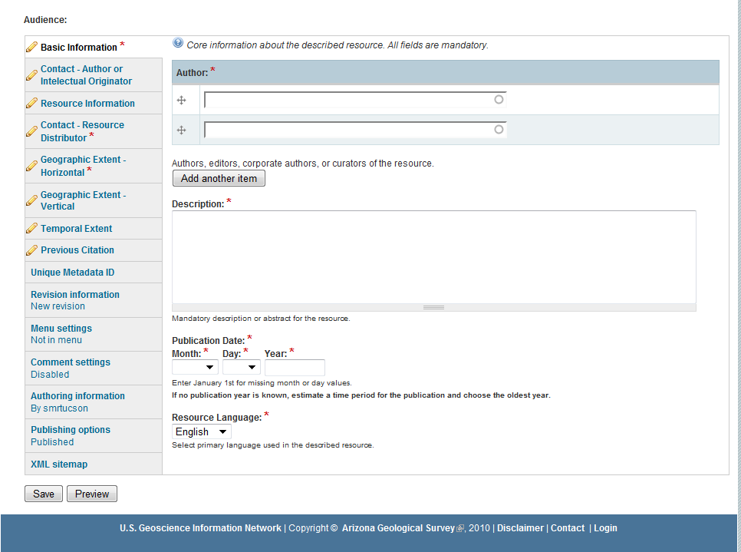
Content groups
Required content *
Autocomplete
Prepopulate from collection
http://mw.usgin.org AND http://repository.usgin.org

Slide 28
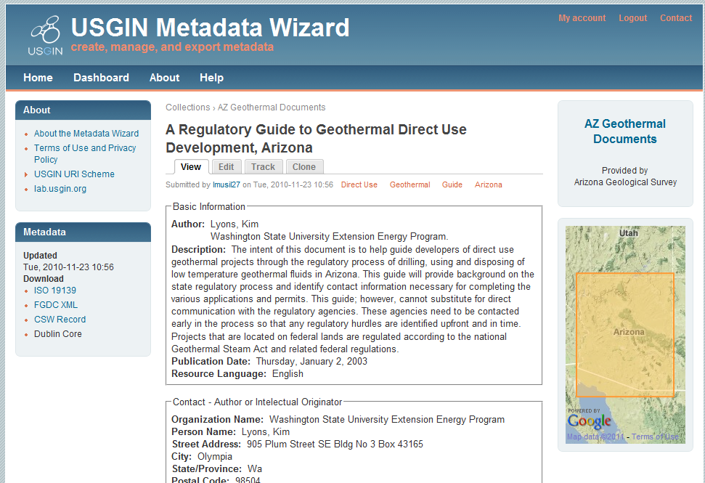
View in different encodings

Slide 29
Metadata from User Perspective
Search from within the user’s standard workspace (Excel, ArcGIS, ModFlow….)
Natural language labels and instructions
Standardize interface components for creating, searching, browsing metadata
Work against a content model not bound to a particular encoding or standard

Slide 30
Nagging questions
How to leverage commercial search engines
What is sweet spot between structured metadata and text/link-based indexing

Slide 31
Implementing Services
OGC Services

Slide 32
The Services
Protocol
Messaging framework and interface
WFS, WMS, CSW…
Geospatial
Server implementation
GeoServer
ESRI ArcGIS server

Slide 33
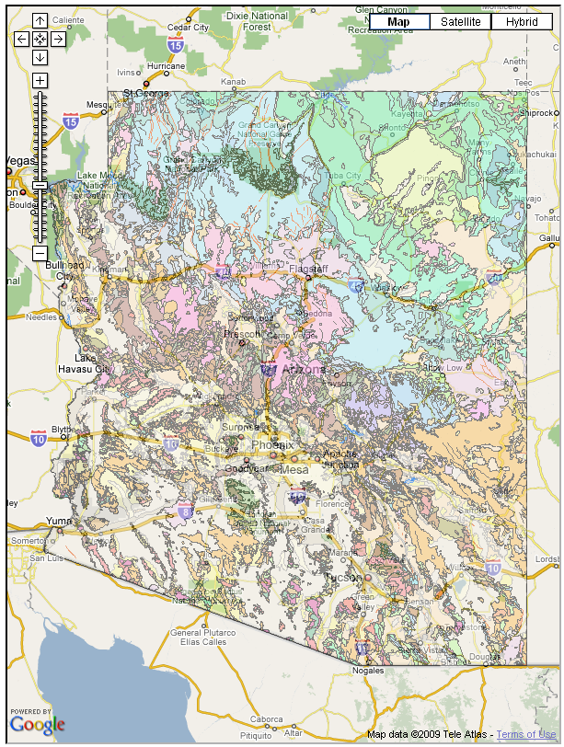
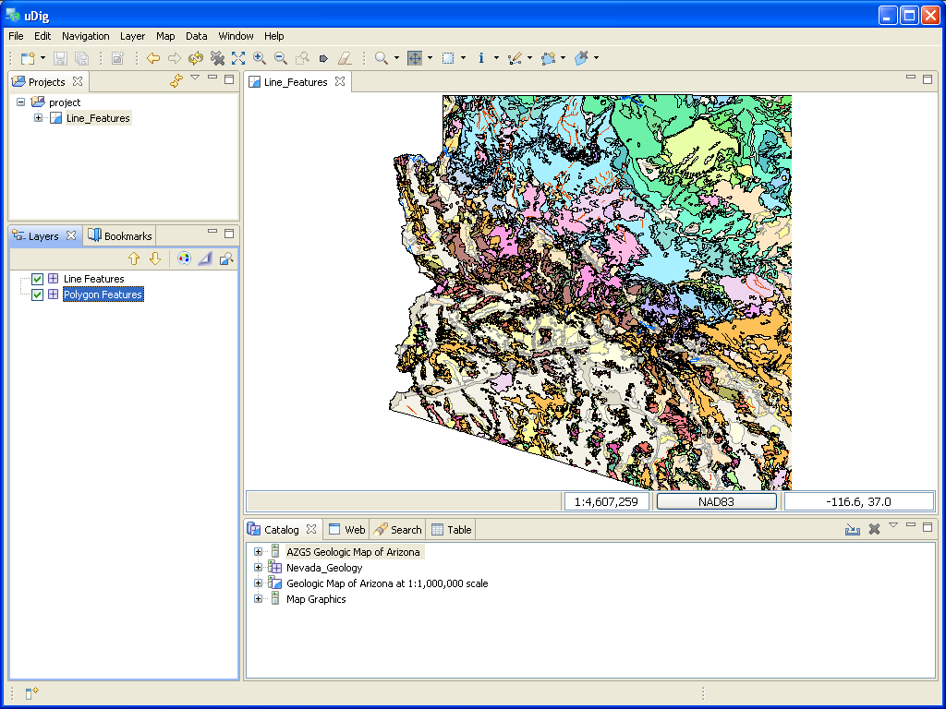
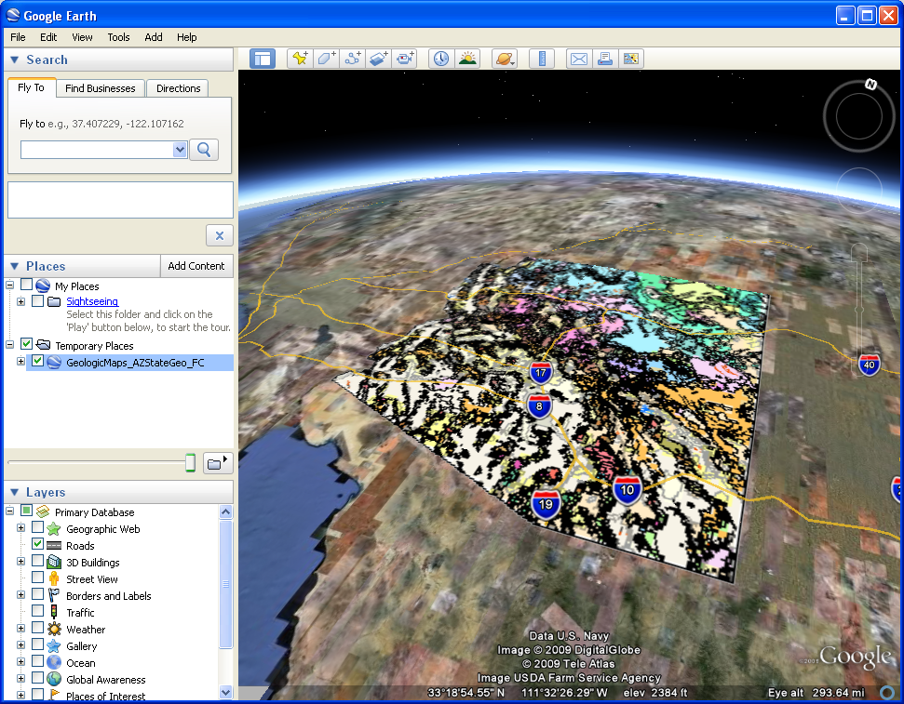
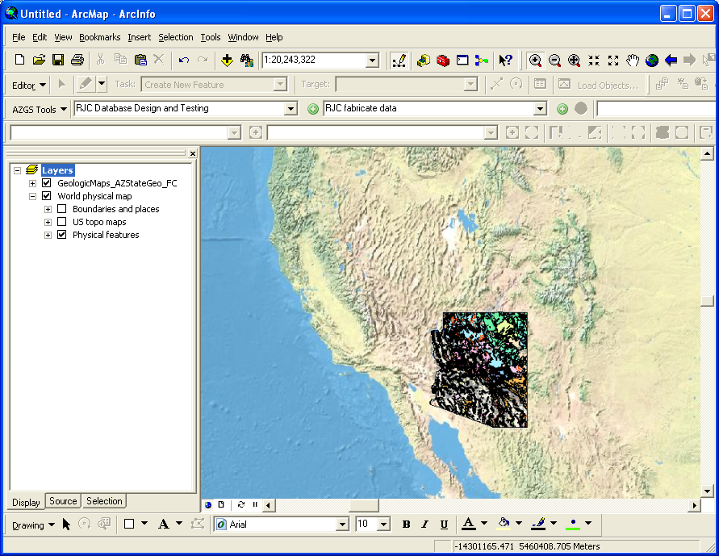
The US Geoscience Information Network
OGC Services
-- Useful in Existing Applications
WMS for providing a symbolized portrayal of vector data
WFS for full access to attributes and to download vector data
WCS for access to continuous raster data

Slide 34
Protocol: WMS
Simple, widely used, many clients
Access to georeferenced map image
Servers
MapServer, GeoServer, Deegree, ArcGIS
Data integration = agreeing on standard portrayal schemes (legends)

Slide 35
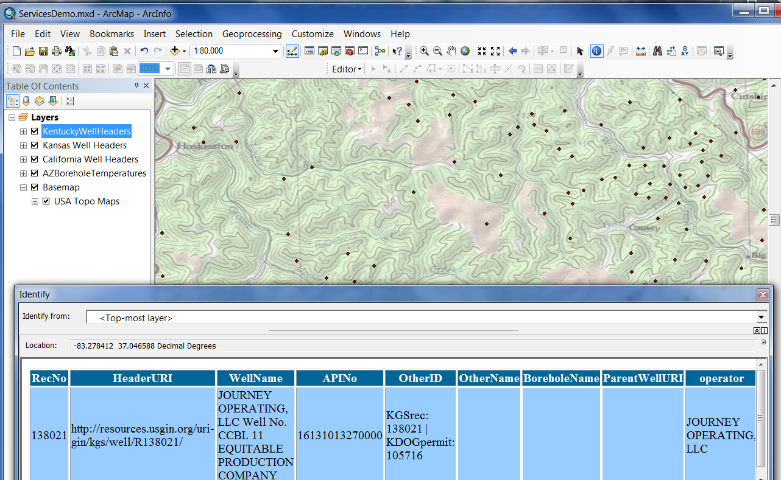
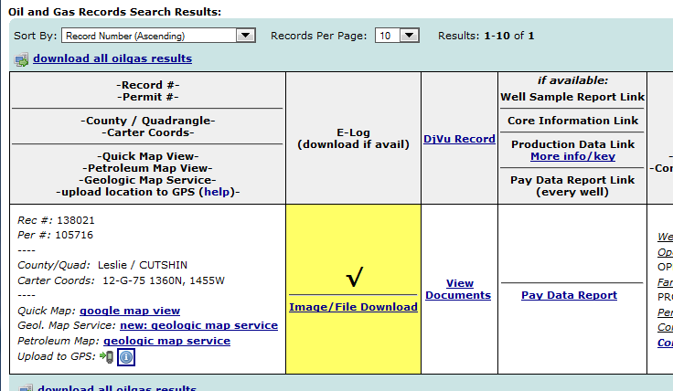
WMS for well headers

Slide 36
Protocol - WFS
Open Geospatial Consortium Web Feature Service
GetCapabilities, GetFeature, DescribeFeature
GML encoding of content
Each service defines feature content model (xml schema)
Feature service –
designed for data access based on features (representation of geolocated entity with attributes)

Slide 37
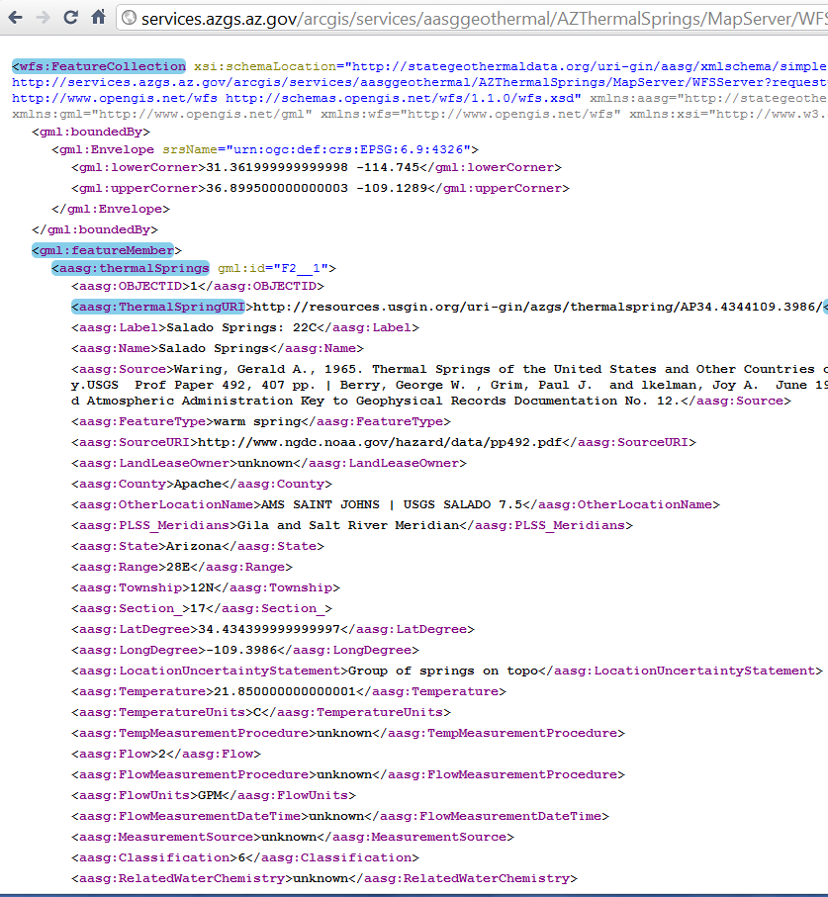
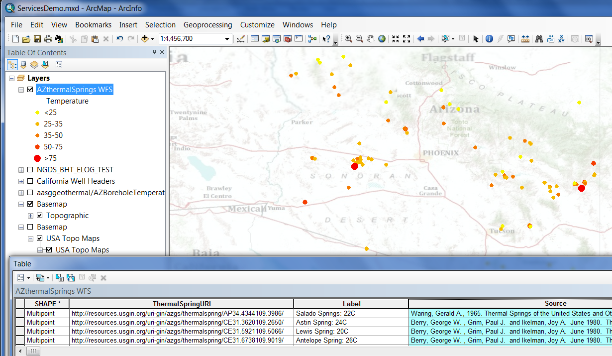
WFS example

Slide 38
Protocol: ArcGIS services
If using ArcGIS software clients, service is transparent
Other client libraries are available (Flex, OpenLayers)
ESRI has submitted Geoservices REST API for consideration as OGC standard

Slide 39
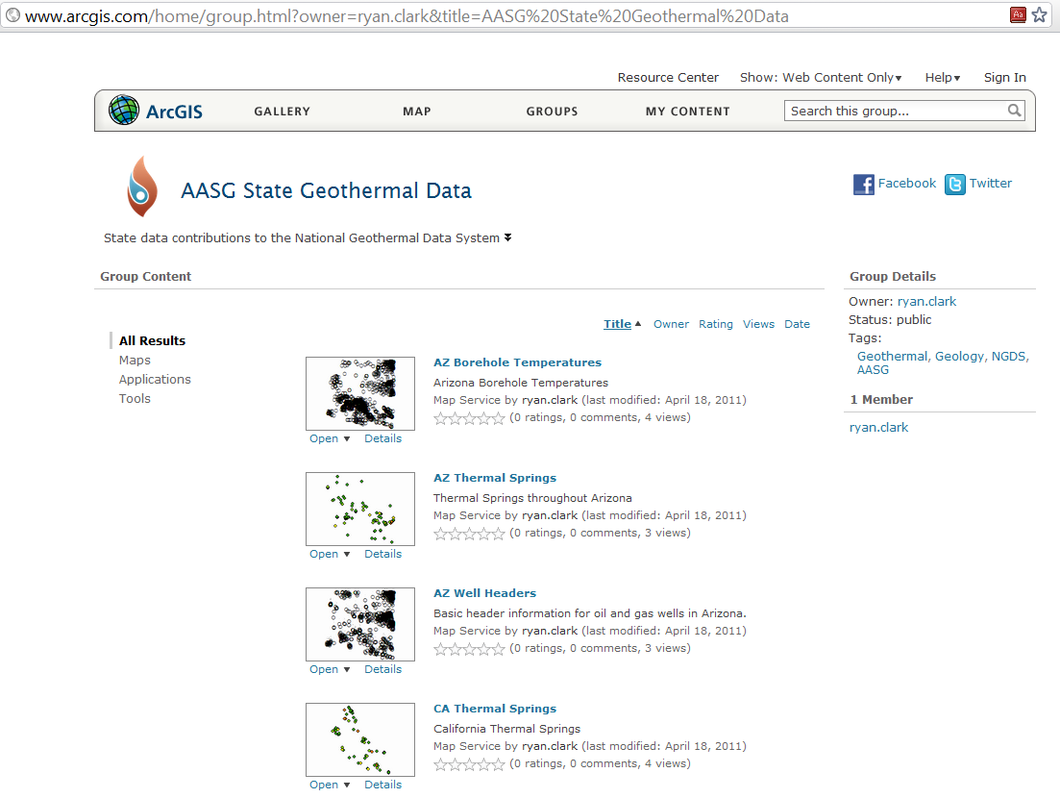
AASG State Geothermal data at ArcGIS.com

Slide 40
Standardizing Content
This is the hardest part.

Slide 41
Consistent Attributes Across State Boundaries

Slide 42
Feature Service inventory: trade-offs
Many services, simple content
More traffic on network—more calls
Client complexity: marshal related information from a variety of services
Few services, complex content
Less network traffic, fewer calls
Client complexity: unravel complex response documents

Slide 43
Interchange formats: complex Features
COST—
Difficult to validate and QA
Client complexity – mostly have to build your own
Steep learning curve
BENEFITS
Great expressive capability—accurate representation of science information
Complex schema
OGC sensor web schema for observations
GeoSciML for Geologic information
ISO19139 for metadata

Slide 44
Simple Features
Simple point, line, or polygon geometry
Attributes are text, number, or date
Essentially a shape file encoded in GML (with fewer limitations)
Service is easy to set up
ArcGIS client out of the box
Enables XML schema and rule-based (schematron) validation
Namespaces indicate schema version to clients

Slide 45
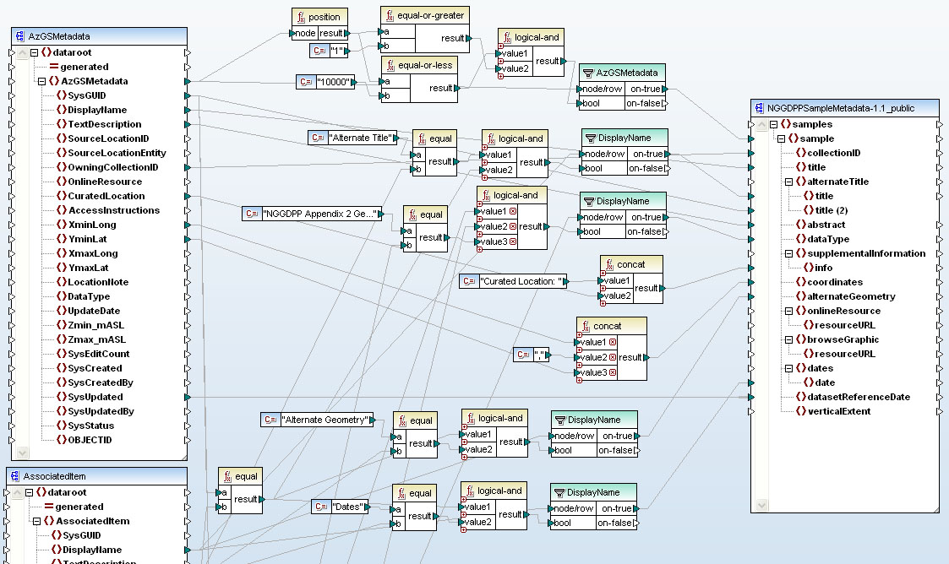
Data Integration
Transforming data to another schema stinks.
I only want to do it once

Slide 46
Content Models: interchange
Geologic map: contact, fault, outcrop
Geologic Unit geothermal
characterization
Gravity station observation
Heat flow measurement
Hot spring description
Metadata
Permeability
Production statistics record
Rock chemistry
Thermal conductivity measurement
Well header
Volcanic vent description
Active Fault
Alteration description
Borehole temperature data
Crustal Stress data
Developed geothermal system feature
Direct use feature
Drill stem test
Earthquake hypocenter
Enhanced geothermal system feature
Aqueous chemistry

Slide 47


Slide 48
Architecture concepts
Loose coupling
Feature-level data integration by data provider
Use http URI to identify resources
Services registered in catalog system
Network is defined by interfaces and interchange formats
Interchange formats and profiles are reviewed, registered, versioned, and documented

Slide 49
Artifacts
Technologic
Repository
Specifications
Vocabularies
Documentation of practice
Resource registry
Hardware hosts
Testing and validation resources
Usage monitoring and reporting

Slide 50
Artifacts
Social
Processes for developing, review, adopting artifacts
Mailing list/membership
Organization procedures, transfer of leadership
Staff positions
Brand
Data source linkage to network
End user facing linkage
Connections between community and software developers (vendor community)
Feedback mechanisms/evaluation/review
With ultimate providers of information

Slide 51
Artifacts
Educational
Tutorials
Training materials, videos, etc.
Demonstration software
Wiki, collaborative online tools
Blogs

Slide 52
The US Geoscience Information Network
Building the System: Social Engineering
More
Data
Starting a bootstrapping process
Use of existing protocols means lots of software is already available
Striving to provide simple transformation tools to ease the barrier to entry
The more the merrier!
More
Users
More
Software

Slide 53
Making standards happen?
A standard is a product that ships in volume
Some party develops a specification for how to do something
Other people see it working and want to do the same thing
Requires documentation, outreach, training
Requires commitment to reusing/extending existing work rather than reinventing.
Darwinian process
Standard implies stewardship: versioning, stability, orderly progress

Slide 54
Where to now
Evolving organization landscape
USGIN CDI
DataONE
Earth Science Information Partners (ESIP)
Evolving technology landscape
Resource oriented approaches (“REST”)
OpenSearch
Lighter weight encoding (JSON)
Organic Process
Emerging System

Slide 55
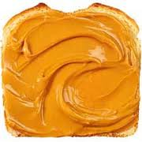
Moving community forward
What kind of community
Community engagement takes time and effort
Has to yield benefits
More efficient work
Professional recognition
Sense of identity
Business value to individuals and organizations
Are we spread too thin?

Slide 56
USGIN Summary
Lots of work on discovery
ISO metadata
Carefully considered profile
ESRI geoportal
Use services that have out of the box clients and servers
Keep content schema simple
Use existing information as guide

Slide 57
Current GIN Documents
Metadata recommendations– content model based on user scenarios
Profile for ISO metadata – detailed profile for interoperable metadata using ISO schema for geoscience resources
URI scheme
http://lab.usgin.org

Slide 58
AASG Geothermal data
Catalog file-based resources in repositories
Simple feature (flat file) schema
Basic borehole description (well header)
Borehole temperature measurements
Hot springs
Active fault
More on the way – geologic units, geochemical data, samples, heat flow…
http://stategeothermaldata.org
The goal is simple, really….

Slide 59

turn this….
Winona State U.

Slide 60
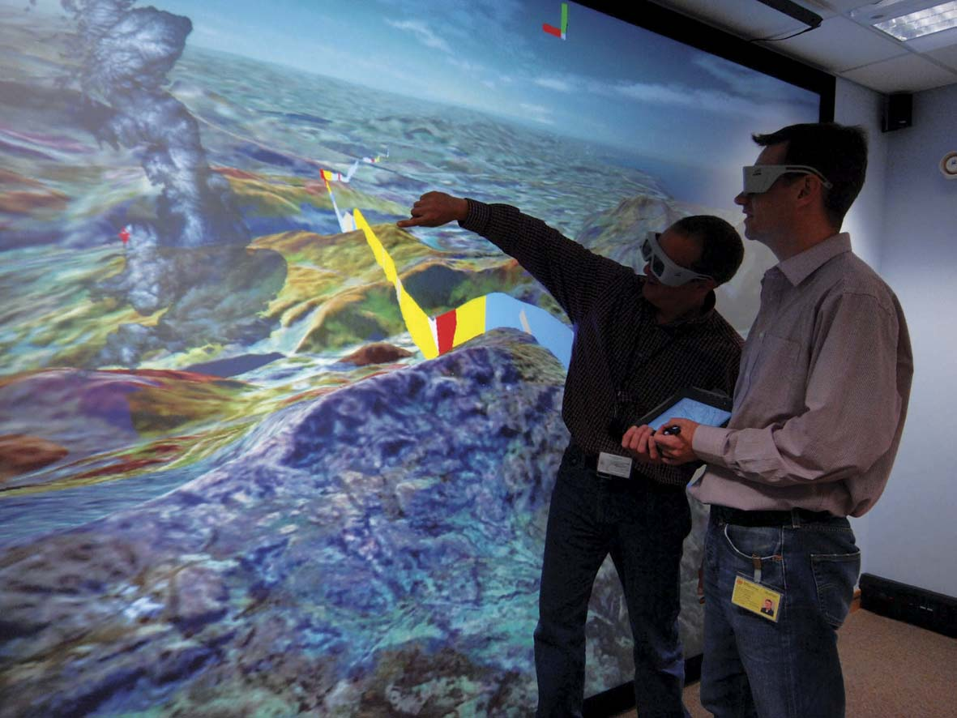
….into this
NERC 2008
Notes:
60
60

Slide 61
Thank You
Stephen Richard
Arizona Geological Survey
Steve.richard@azgs.az.gov
http://lab.usgin.org http://stategeothermaldata.org

